Slide 1

Prediction of FOREX rates using a Hybrid System
Nathan D’Lima
Under the Guidance of
Prof. Shamsuddin S. Khan
30/01/16
Computer Department,
St. Francis Institute of Technology

Slide 2
CONTENTS
Introduction
Problem Statement
Literature survey
Proposed work
Result Analysis
Conclusion
References

Slide 3
Introduction
Foreign currency exchange or FOReign EXchange is called FOREX or FX.
It is a global decentralized market for the trading of currencies.
The foreign exchange market determines the relative values of different currency pairs.
The foreign exchange market is unique because of the following characteristics:
Its huge trading volume
Its geographical dispersion;
Its continuous operation: 24 hours a day except weekends
The variety of factors that affect exchange rates;
The low margins of relative profit compared with other markets of fixed income

Slide 4
Introduction
Currency exchange is the trading of one currency against another.
Home currency – currency to convert
Foreign currency – currency to which home currency is converted
Purchase of goods via the internet where the amount to be paid may be in a foreign currency.
Major traders of Foreign Currency:
Private and Central Banks
Investment managers
Hedge funds
Corporations

Slide 5
PROBLEM STATEMENT
The main drawback of current systems is the inability to provide high accuracy rates for future predicted values. A simple neural network gives low accuracy.
The objective is to predict future exchange rates (for USD to INR) using a Hybrid System that combines a Artificial Neural Network to predict the rise or fall of the market and an ANFIS model to predict the future rate with greater accuracy.

Slide 6
LITERATURE SURVEY
Reference | Currencies | Training sample
Emad F, M.A. Montazeri [1] | EURUSD USDCHF | From 1st April 2005 to10th December 2012
A. Cwiok, M. Kordos [2] | (Stock Trading) | From 1st January 1995 to 31st December 2004
B. Christina, Y. Masoud [3] | USDGBP, USDEUR, USDCHF | From 3rd January 2012 to 1st March 2013
V. Kodogiannis and A. Lolis [5] | USDGBP | From end of 1997 to end of March 2000
A.N. Kia, M. Fathian and M.R. Gholamian [6] | EURUSD | From 1st August 2001 to 31st July 2010
Chandar, Sumathi and Sivanandam [9] | INRGBP, INRUSD, INREUR, INRJPY | January 2008 to December 2012
B Gharleghi, A Nor [10] | MYR/USD | January 1998 to September 2010

Slide 7
LITERATURE SURVEY
Reference | Method | Performance
Emad F, M.A. Montazeri [1] | FLIT2FNS - IT2 fuzzy system without clustering combined with FLANN neural network T1FCMFNS - Type-1 implementation of created system IT2FCMFNS - IT2 FCM based IT2 Neuro-Fuzzy System |  | EURUSD | USDCHF
 |  | FLIT2FNS | 0.00613 | 0.00582
 |  | T1FCMFNS | 0.00172 | 0.00207
 |  | IT2FCMFNS | 0.00165 | 0.00101
V. Kodogiannis and A. Lolis [5] | MLP with BP RBF ARNN AFLS |  | %Error | RMSE
 |  | MLP | 0.31 | 0.421
 |  | RBF | 0.2646 | 0.3905
 |  | ARNN | 0.2711 | 0.4021
 |  | AFLS | 0.2514 | 0.3939
A.N. Kia, M. Fathian and M.R. Gholamian [6] | Single ARIMA Single MLP Single RBF Hybrid (ARIMA+MLP+RBF) |  | RMSE | D-stat
 |  | ARIMA | 0.0081 | 65%
 |  | MLP | 0.0076 | 67%
 |  | RBF | 0.0085 | 59%
 |  | Hybrid | 0.0068 | 71%

Slide 8
LITERATURE SURVEY
Reference | Method | Performance
Chandar, Sumathi and Sivanandam [9] | Batch gradient descent, Batch gradient descent with adaptive learning, Resilient Back propagation |  | RMSE | MAE | MAPE
 |  | GBP | 0.0374 | 0.0274 | 0.845
 |  | USD | 0.02 | 0.0141 | 0.526
 |  | EUR | 0.0346 | 0.0256 | 0.661
 |  | JPY | 0.1323 | 0.0175 | 1.226
B Gharleghi, A Nor [10] | Random Walk, ANN, Neuro-Fuzzy |  | RW | NN | Neuro-Fuzzy
 |  | RMSE | 0.3313 | 0.00308 | 0.0433
 |  | MAE | 0.2653 | 0.00107 | 0.0235
 |  | MAPE | 6.8 | 1.1 | 8
 |  | VP | 0.1949 | 0.00131 | 0.00324
B. Christina, Y. Masoud [3] | Neural Network VSSA RSSA | Basic RSSA – 60% accuracy Neural Network – 48% accuracy (SSA 67% better than NN)

Slide 9
PROPOSED WORK
Propose a new technique which uses an Artificial Neural Network and with back propagation and a Hybrid Neuro-Fuzzy System.
Apply methods used in stock market prediction to predict rise and fall of FOREX rates.
A ANN with standard back propagation algorithm to determine trend of the market.
It takes 4 inputs and gives the trend of the market as output.
Dataset
From: http://www.oanda.com/currency /historical-rates/
Records from 1st November 1993 till date for USD to INR

Slide 10
PROPOSED ANN ARCHITECTURE
CP
SMA
Rise / Fall of FOREX market
EMA
Predicted Output
ROC
Feedforward
Update Weights
Feedback
Error
Actual Output
─
Figure 1: MLP Network with Back Propagation

Slide 11
Required Formulae ^{[7]}
For input data set y and weights w –
Value of net at each node k :
Activation function at each node :
Error at output :
Weight update :
(1)
(2)
(3)
(4)
(5)
(6)

Slide 12
Inputs and Output
Inputs:^{[2], [11]}
Closing price : The daily closing rates for USD v INR is taken.
ROC: Rate of Change for the past 14 days given by-
SMA : Simple Moving Average of the past 14 days given by –
EMA : Exponential Moving Average given by –
No of hidden neurons :
Based on experiments conducted (as shown in Figure 2), 5 hidden neurons are required with Learning rate 0.1 and Momentum 0.25
Outputs:
Trend of the FOREX Market.
(7)
(C_{i} is the closing Price)
(8)
(9)

Slide 13
Determination of Number of Hidden Neurons
Figure 2: Determination of Number of Hidden Neurons based on Learning rate and Momentum

Slide 14
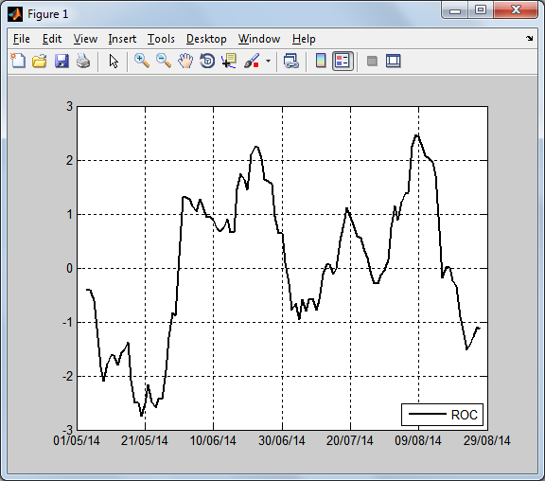
Rate of Change
Figure 3: Rate of Change

Slide 15
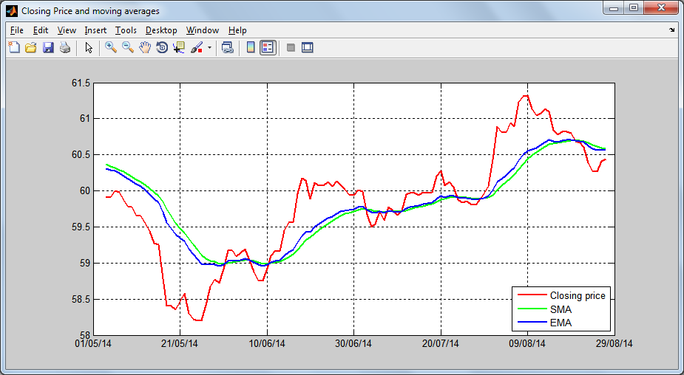
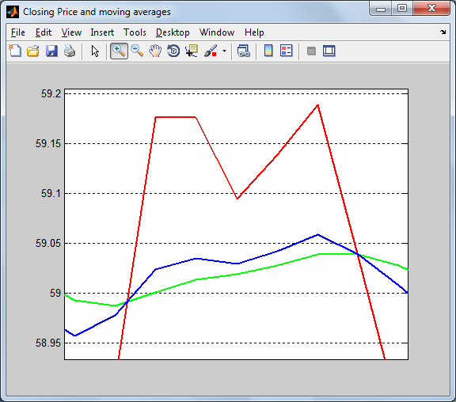
Closing Price and Moving Averages
Figure 4: Closing Price, SMA and EMA

Slide 16
PROPOSED WORK
The second method uses a hybrid Adaptive Neuro Fuzzy Inference System (ANFIS) to predict the FOREX rate accurately.
It takes 2 inputs and gives the predicted exchange rate as output.
Fuzzification of the inputs is done using a Gaussian Membership function.
ANFIS uses a Type-1 Sugeno Fuzzy Inference System to generate the rules.

Slide 17
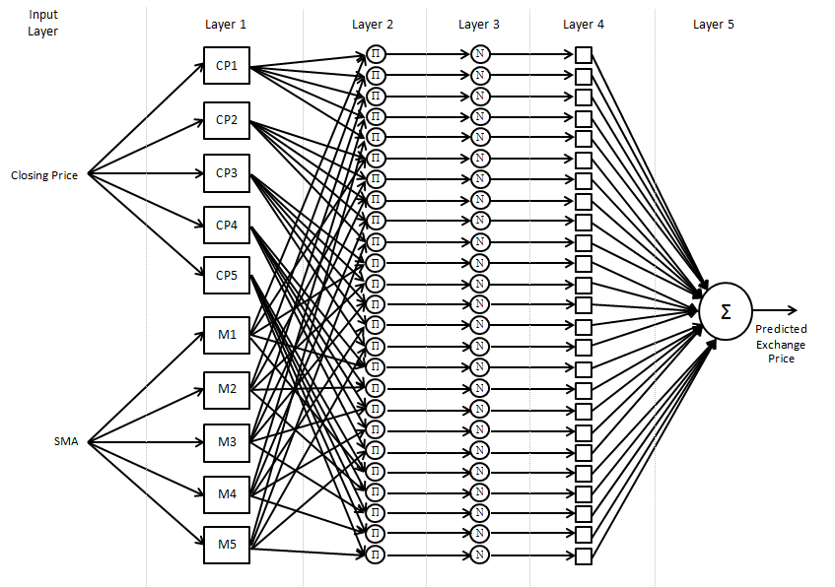
ANFIS ARCHITECTURE
A₁
Closing Rate
W₁
π
N
f₁
A₂
Predicted FOREX rate
Σ
B₁
Moving Average
π
N
f₂
W₂
B₂
Input Layer
Layer 1
Fuzzfication
Layer 2
Firing strength
Layer 3
Normalization
Layer 4
Finding consequent
Layer 5
Defuzzification and Output
Figure 5: ANFIS architecture [8]

Slide 18
Required Formulae ^{[8]}
Layer 1 : Each node is an adaptive node with a node function –
Layer 2 : Each node is an fixed node labelled with output as product of all incoming signals –
(10)
(11)
(12)

Slide 19
Required Formulae ^{[8]}
Layer 3 : Each node is an fixed node labelled N with i^{th} node calculating the normalized firing strength –
Layer 4 : Every node in this layer is an adaptive node, which computes the firing strength of the consequent parameters –
Layer 5 : It has a single fixed node labelled Σ, which computes the overall output as summation of incoming signals –
(13)
(14)
(15)

Slide 20
Inputs and Output
Inputs:
Closing Price : The daily closing rates for USD v INR is taken.
Moving Average : Simple Moving Average is used.
No of Membership Functions
Based on a set of experiments, 5 membership functions are required for each input as shown in Figure 6, 7 and 8.
Output:
Predicted FOREX Rate.

Slide 21
Training and Testing time
No of MF | Training time | Testing time
2 | 19.544 | 0.052
3 | 48.508 | 0.043
4 | 106.512 | 0.045
5 | 230.834 | 0.055
6 | 432.546 | 0.063
7 | 1436.395 | 0.063
8 | 1982.937 | 0.069
Figure 6: Training and Testing time for different membership functions

Slide 22
Mean Square Error
Figure 7: Mean Square Error (MSE) for Training and Testing using different membership functions

Slide 23
Mean Absolute Error
No of MF | Training MAE | Testing MAE
2 | 2.77E-09 | 6.94E-03
3 | 8.90E-09 | 6.80E-03
4 | 3.23E-08 | 6.96E-03
5 | 4.52E-08 | 6.27E-03
6 | 8.23E-08 | 8.92E-03
7 | 9.04E-08 | 8.37E-03
8 | 1.66E-07 | 8.85E-03
Figure 8: Mean Absolute Error (MAE) for Training and Testing using different membership functions

Slide 24
Dataset
Currency pair : US Dollar (USD) per Indian Rupee (INR)
Data points :
Daily closing rates from 1st November 1993 till 29th January 2016 (8139 records)
Number of Training Records : 6104 (75%)
Number of Testing Records : 2035 (25%)
Data source :
http://www.oanda.com/currency/historical-rates/

Slide 25
Result Analysis
Performance Parameters ^{[9],[10]}
Time
Training Time and Testing time
Mean Square Error (MSE)
(16)
Mean Absolute Error (MAE)
(17)

Slide 26
Result Analysis
n = 5
e_{i} = P_{i} - A_{i}
e1 = 3 – 2 = 1
e2 = 3.5 – 3 = 0.5
e3 = 2.5 – 1 = 1.5
e4 = 1 – 2 = -1
e5 = 0.5 – 1 = -0.5
e2
e1
e3
e4
e1² = 1*1 = 1
e2² = 0.5*0.5 = 0.25
e3² = 1.5*1.5 = 2.25
e4² = -1*-1 = 1
e5² = -0.5*-0.5 = 0.25
e5
Figure 9: MSE and MAE Example
MSE = (1/5)*[e1²+ e2²+ e3²+ e4²+ e5²]
= (1/5)*[1 + 0.25 + 2.25 + 1 + 0.25]
= (1/5)*[4.75] = 0.95
MAE = (1/5)*[|e1| + |e2| + |e3| + |e4| + |e5|]
= (1/5)*[1 + 0.5 + 1.5 + 1 + 0.5]
= (1/5)*[4.5] = 0.9

Slide 27
Result Analysis
Figure 10: Training Time in seconds
(5910 records, 500 epochs)

Slide 28
Result Analysis
Figure 11: Testing Time in seconds
(1182 records, 500 epochs)

Slide 29
Result Analysis
Figure 12: MSE for Training and Testing

Slide 30
Result Analysis
Figure 13: MAE for Training and Testing

Slide 31
Conclusion
Forex prediction minimizes risks and maximized profits.
Prediction allows traders to use various strategies and trade various currencies to obtain maximum profit.
Hybrid Systems perform better than individual systems like NN, ARNN, RBF, etc.
Combination of ANN (to check trend of market) and Hybrid Neuro-Fuzzy System (to predict the rate) provides a more robust and accurate system.

Slide 32
REFERENCES
[1] Emad F, M.A. Montazeri, “ Forecasting Foreign Exchange Rates Using an IT2 FCM based IT2 Neuro-Fuzzy System” in 21st Iranian Conference on Electrical Engineering (ICEE), 2013.
[2] A. Cwiok, M. Kordos, “A New Approach to Neural Network Based Stock Trading Strategy”, in Intelligent Data Engineering and Automated Learning - IDEAL 2011Lecture Notes in Computer Science Volume 6936, 2011, pp 429-436.
[3] B. Christina, Y. Masoud, “FORECASTING EXCHANGE RATES: AN OPTIMAL APPROACH” in J Syst Sci Complex (2014) 27: 21–28.
[4] http://fxtrade.oanda.com/learn/technical-analysis-for-traders/ stochastic/summary

Slide 33
REFERENCES
[5] V. Kodogiannis and A. Lolis, "Prediction of foreign exchange rates by neural network and fuzzy system based techniques," in European Symposium on Artificial Neural Networks Bruges (Belgium), April 2001, pp. 245-250
[6] A.N. Kia, M. Fathian and M.R. Gholamian, “Using MLP and RBF Neural Networks to Improve the Prediction of Exchange Rate Time Series with ARIMA”, International Journal of Information and Electronics Engineering, Vol. 2, No. 4, 2012, pp. 543-546
[7] Jacek M. Zurada, Introduction to Artificial Neural Systems, West Publishing Company, 1999.
[8] J.S.R. Jang, C.T. Sun and E. Mizutani, Neuro-Fuzzy and Soft Computing – A Computational Approach to Learning and Machine Intelligence, Prentice-Hall Inc., 1997.

Slide 34
References
[9] SK Chandar, M Sumathi, SN Sivanandam, “Neural Network Based Forecasting of Foreign Currency Exchange Rates”, International Journal on Computer Science and Engineering (IJCSE). Vol. 6 No.06 Jun 2014.
[10] B Gharleghi, AHSM Nor, “Hybrid System Application For Time Series Forecasting:The Case Of Myr/Usd Exchange Rate”, In: International Handbook of Academic Research and Teaching. Volume 22, San Antonio, Texas. Spring 2012.
[11] http://stockcharts.com/school/doku.php?id=chart%20_school: technical_indicators

Slide 35
Publications
[1] Nathan D’Lima, Shamsuddin Khan, “FOREX Rate Prediction Using A Hybrid System”, International Journal of Engineering Research and Technology, Volume 3, Issue 11, November 2014.
[2] Nathan D’Lima, Shamsuddin Khan, “ FOREX rate prediction using ANN and ANFIS”, IEEE International Conference on Internet of Things and Applications, January 2016, Pune. (To be published)

Slide 36
THANK YOU!

